Slide 1
Nitroxide radicals use as spin labels in proteins refine
Liu Youjia
2019/09/20

Slide 2
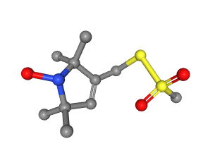


Introduction
Nitroxide Spin Labels
MTN
Proteins
Results

Slide 3
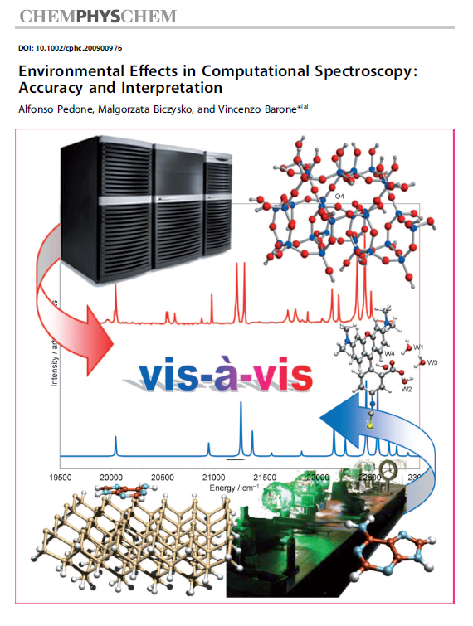
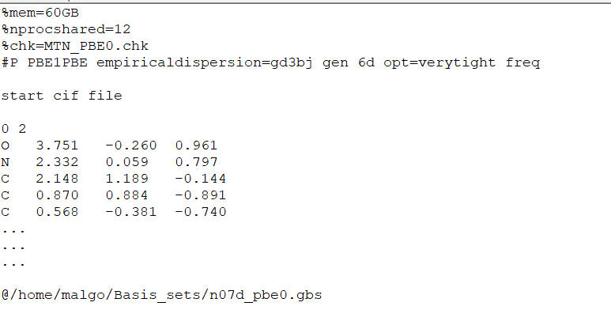
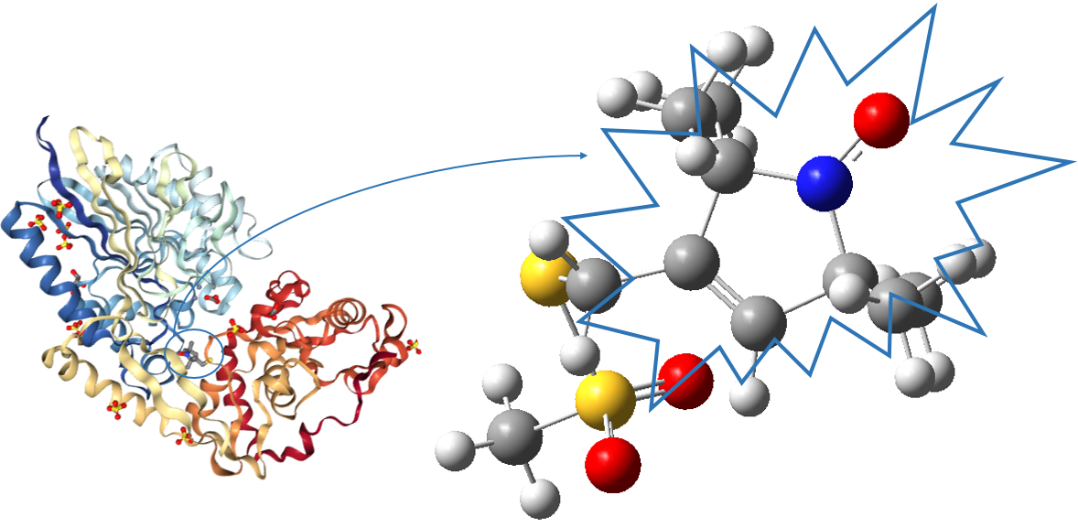
Preparation of refine – get restraint .cif file
MTN

Slide 4
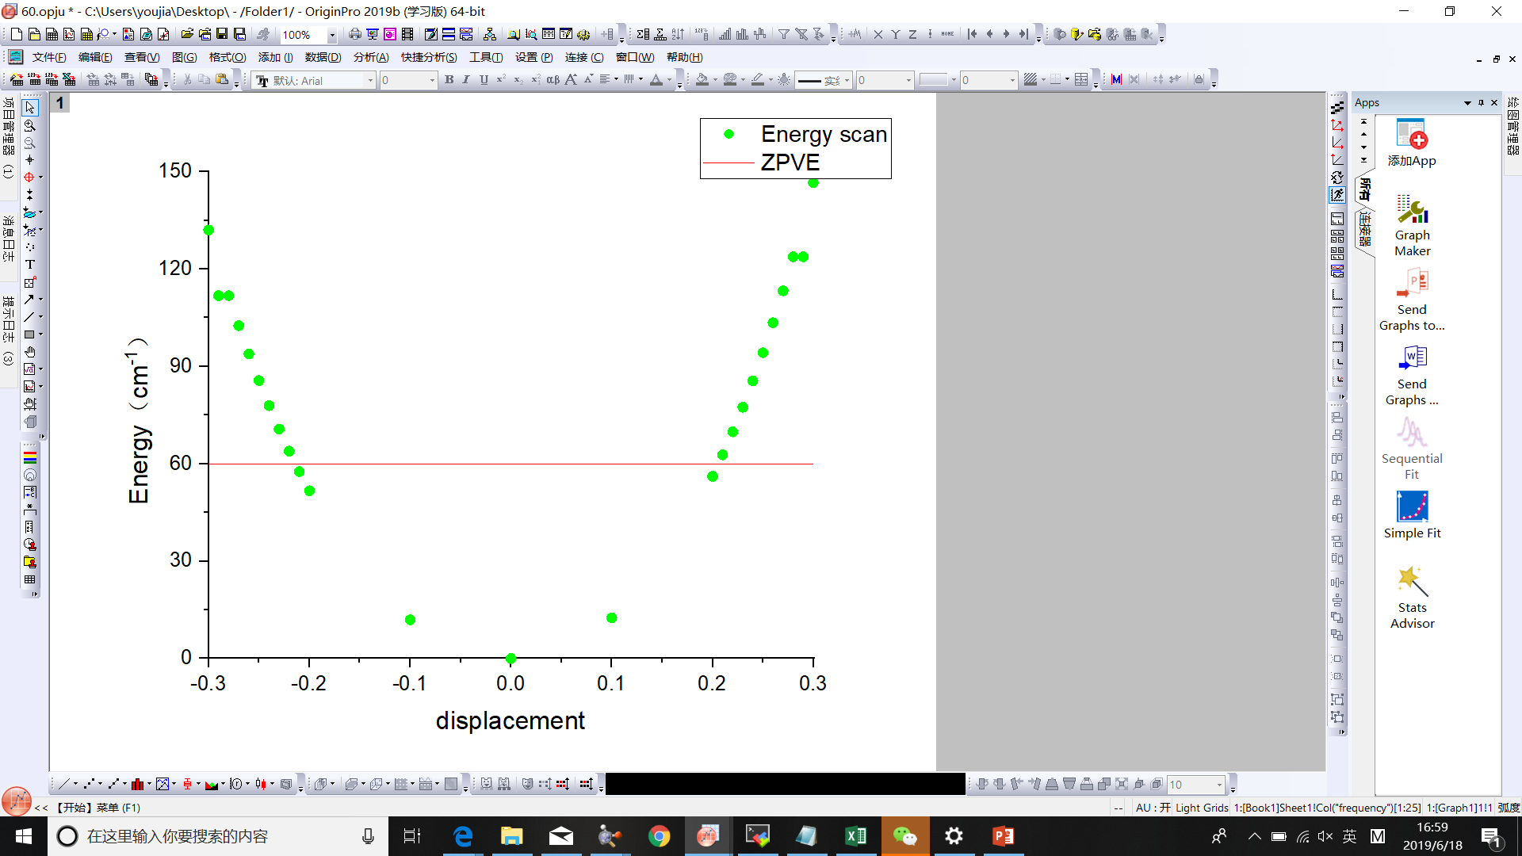
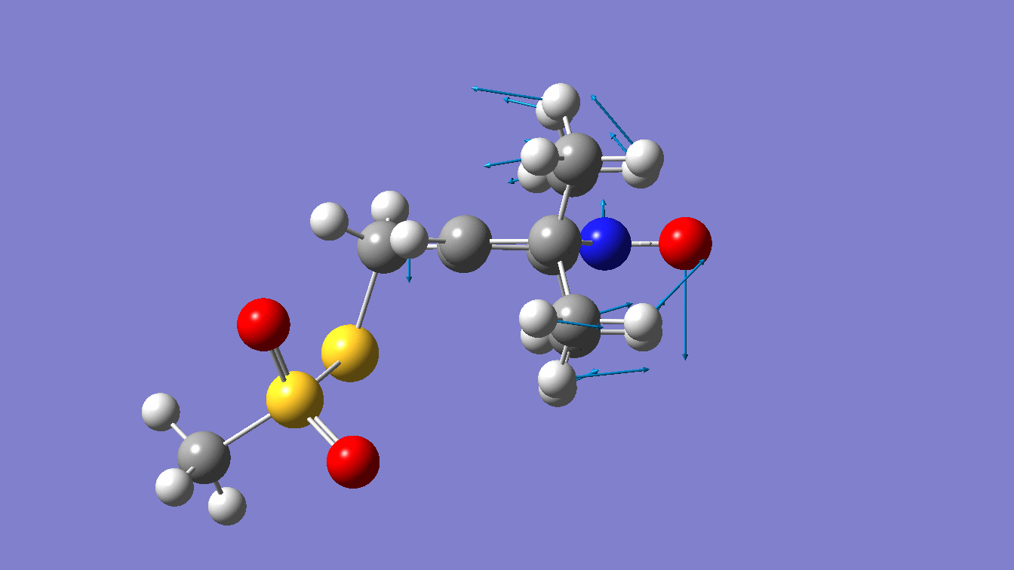
displacement | Energy (cm⁻¹)
-0.30 | 132.02
-0.29 | 111.79
-0.28 | 111.79
-0.27 | 102.53
-0.26 | 93.82
-0.25 | 85.62
-0.24 | 77.91
-0.23 | 70.69
-0.22 | 63.91
-0.21 | 57.58
-0.20 | 51.66
-0.10 | 11.94
0.00 | 0.00
0.10 | 12.53
0.20 | 56.13
0.21 | 62.73
0.22 | 69.83
0.23 | 77.42
0.24 | 85.54
0.25 | 94.21
0.26 | 103.45
0.27 | 113.29
0.28 | 123.74
0.29 | 123.74
0.30 | 146.62
Scan along out-of-plane N=O bending of MTN

Slide 5
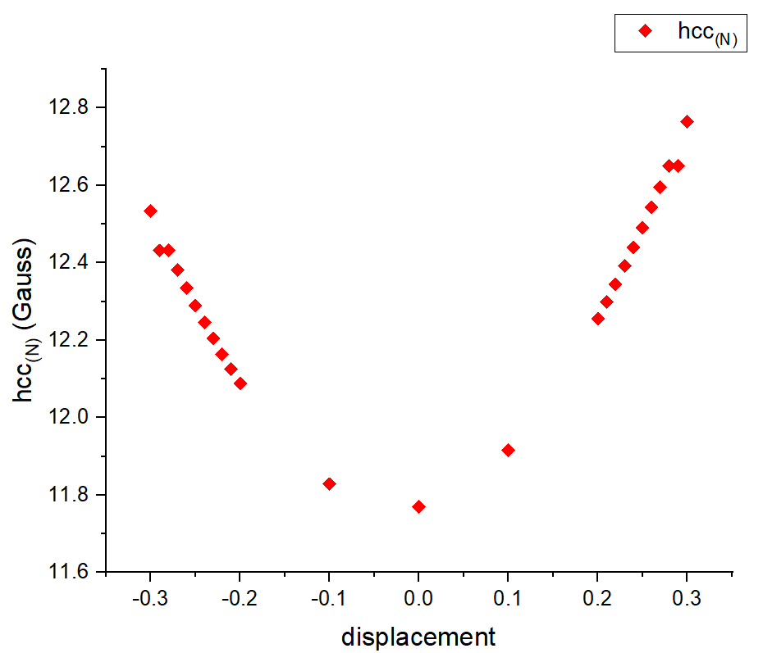
displacement | Gauss（ N ）
-0.30 | 12.53
-0.29 | 12.43
-0.28 | 12.43
-0.27 | 12.38
-0.26 | 12.34
-0.25 | 12.29
-0.24 | 12.25
-0.23 | 12.20
-0.22 | 12.16
-0.21 | 12.13
-0.20 | 12.09
-0.10 | 11.83
0.00 | 11.77
0.10 | 11.92
0.20 | 12.26
0.21 | 12.30
0.22 | 12.34
0.23 | 12.39
0.24 | 12.44
0.25 | 12.49
0.26 | 12.54
0.27 | 12.60
0.28 | 12.65
0.29 | 12.65
0.30 | 12.76
Scan along out-of-plane N=O bending of MTN

Slide 6
Steps of the whole phenix calculate
elbow.refine_geo_display
fetch_pdb
refine
ready_set
pdb_interpretation

Slide 7
UPDATE

Slide 8
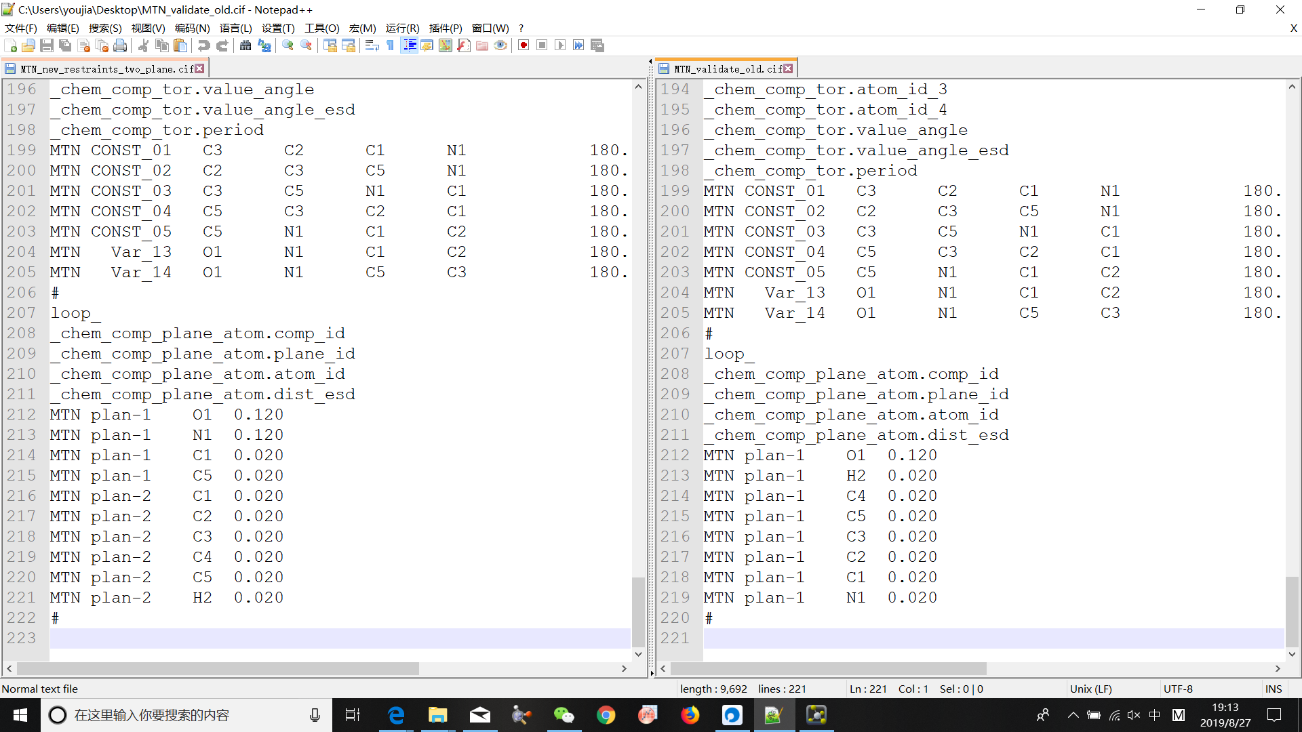
Change of new restraint file

Slide 9
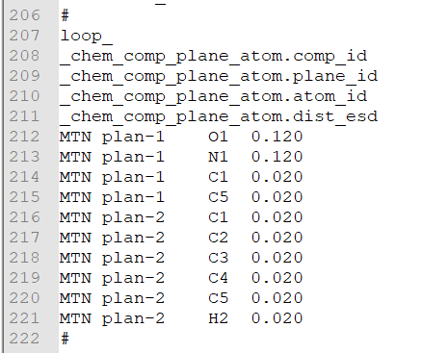
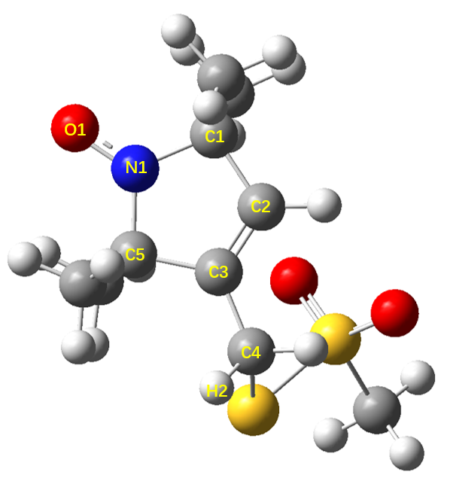
Plane-2
Plane-1
BONDS ( Å )
O1-N1 | C1-N1 | C5-N1
ANGLES
C1-N1-C5 | C1-N1-O1 | C5-N1-O1
DIHEDRALS
C2-C1-N1-O1 C3-C5-N1-O1

Slide 10
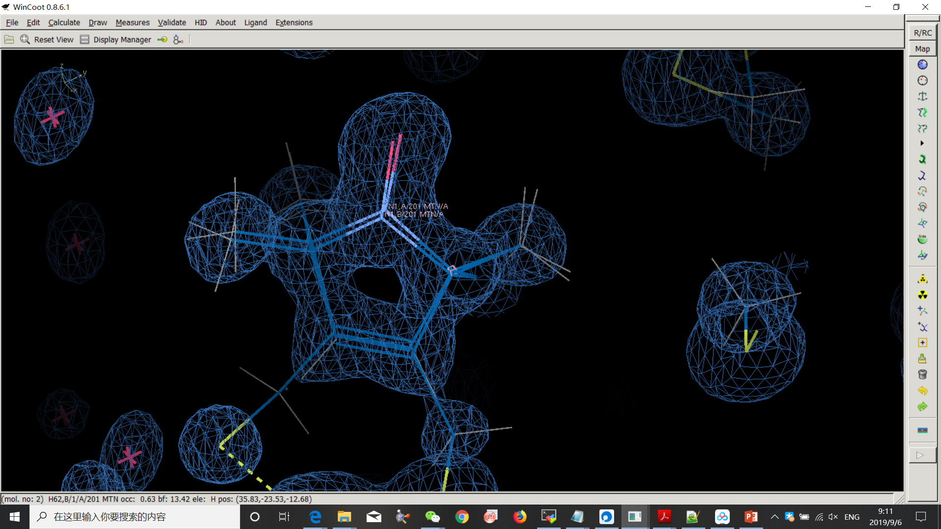
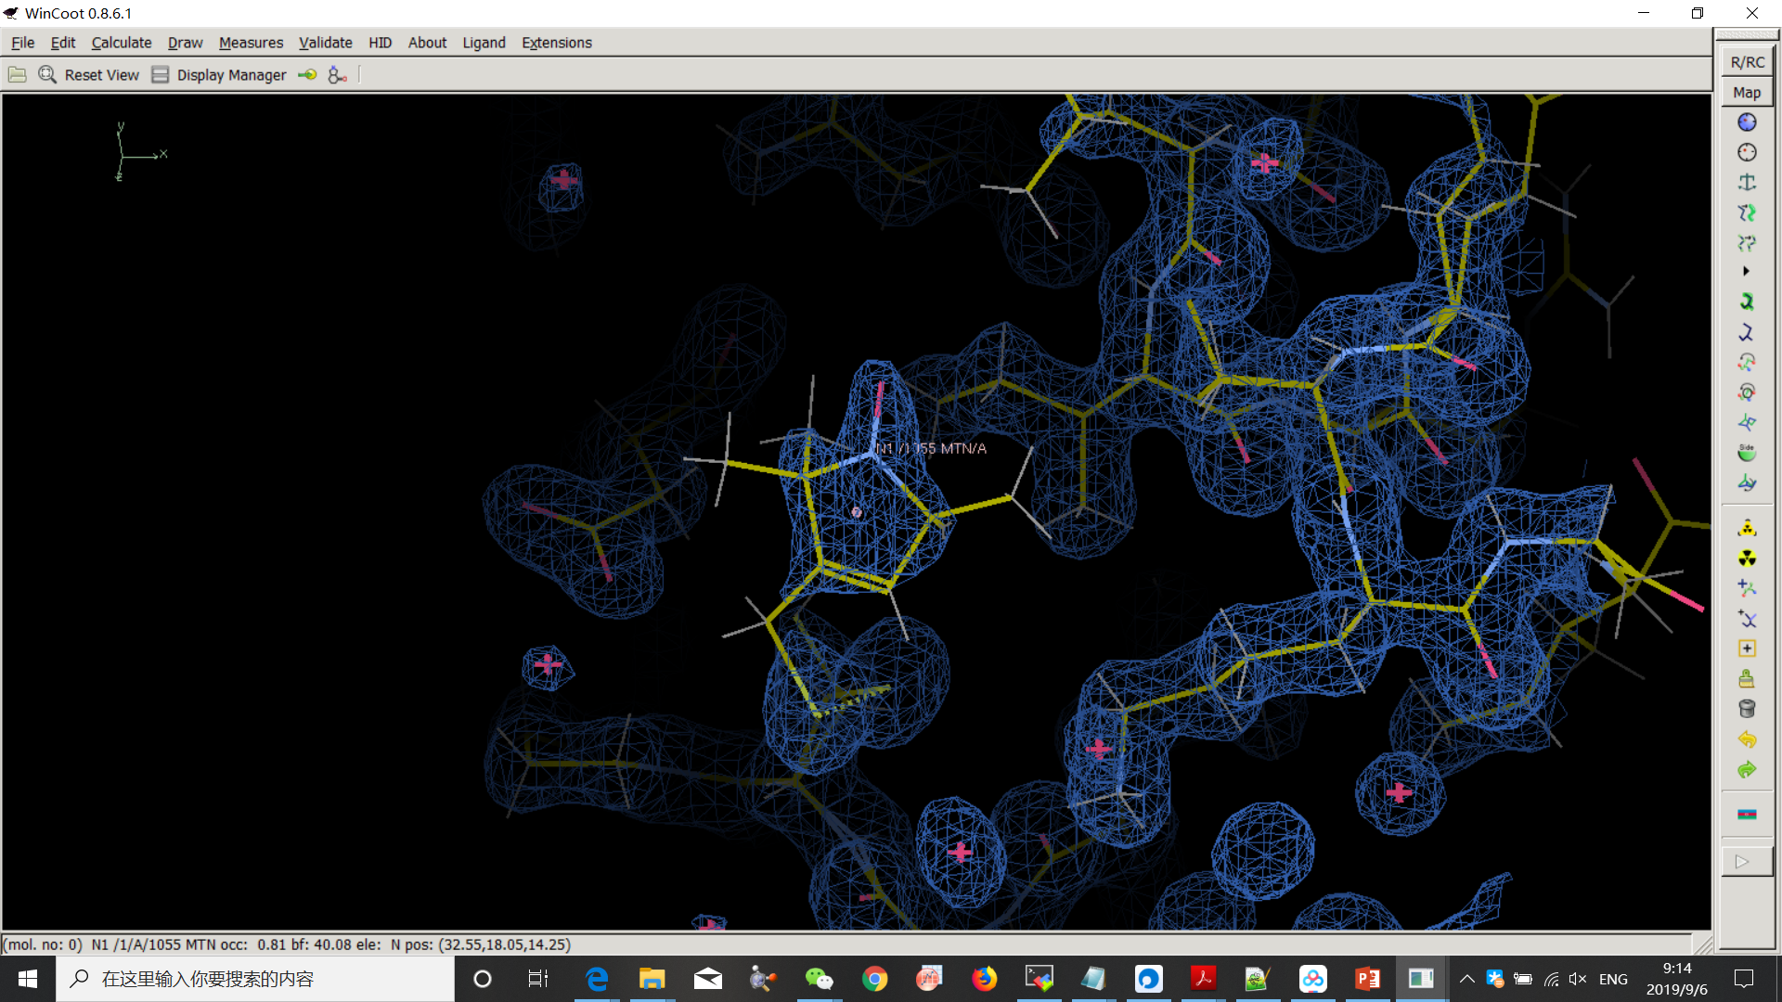
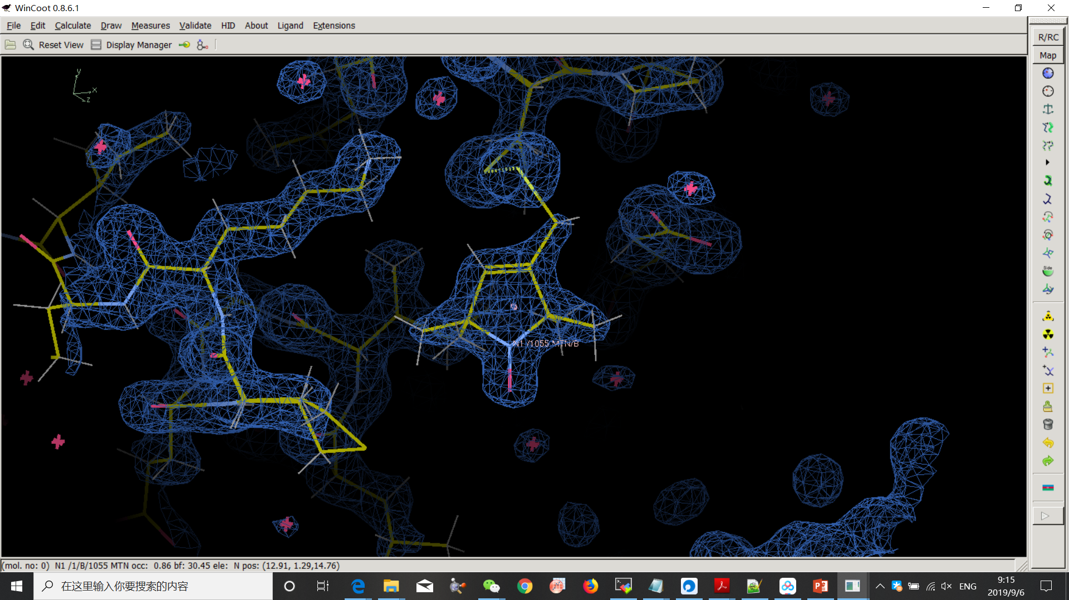
2XIU
5JDT
Resolution ≤ 1.61
2XIU-A
2XIU-B
5BMH-a-A
5BMH-b-A
5G27-a-A
5G27-b-A
5JDT-a-A
5JDT-b-A
6N87-C
Resolution > 1.61
2XGA-A
2XGA-B
3MPN-A
3STZ-C
4EK1-A504
4EK1-B504
4EK1-A505
4WWL-A
5BMI-A
-a, -b… : alternative location
-A, -B… : different chains

Slide 11
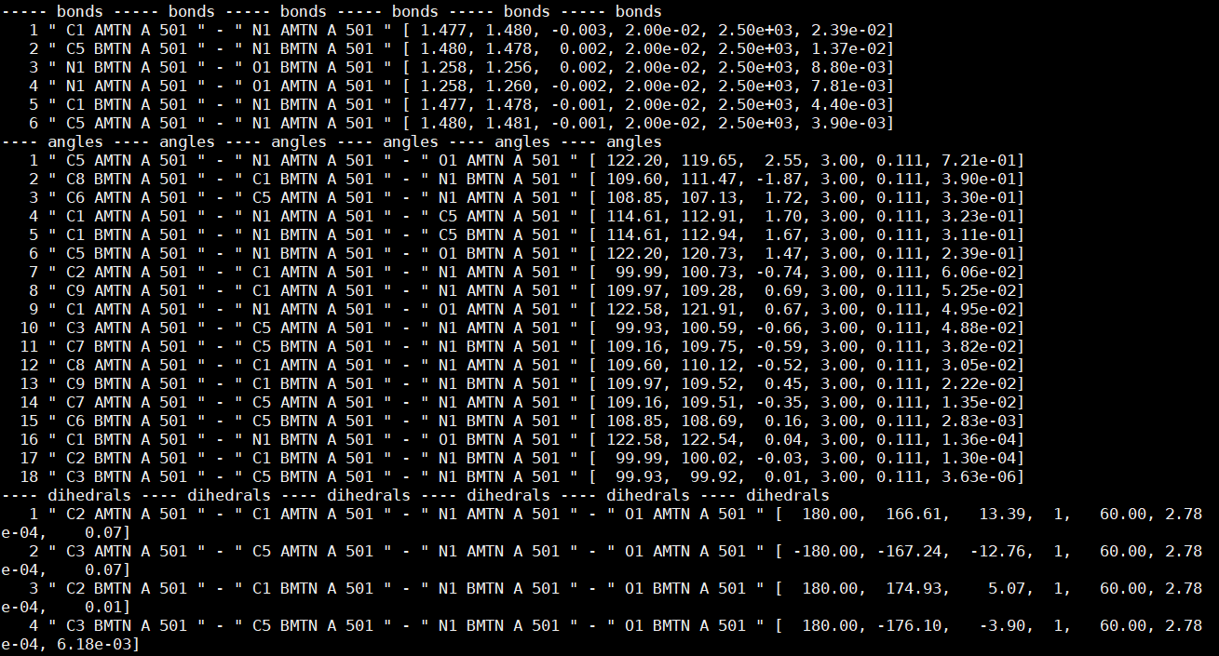
elbow.refine_geo_display 5jdt.updated_refine_001.pdb.geo "MTN N1"

Slide 12
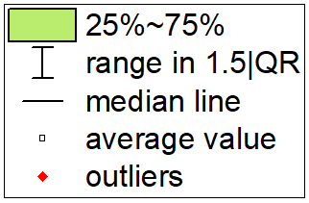
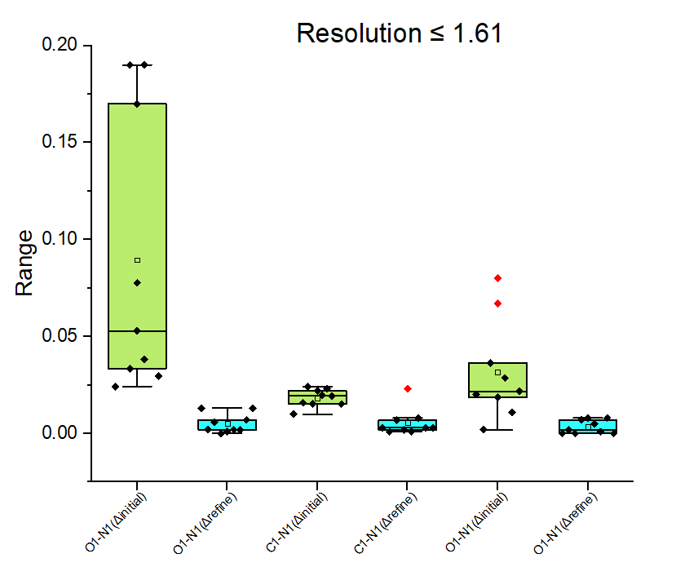
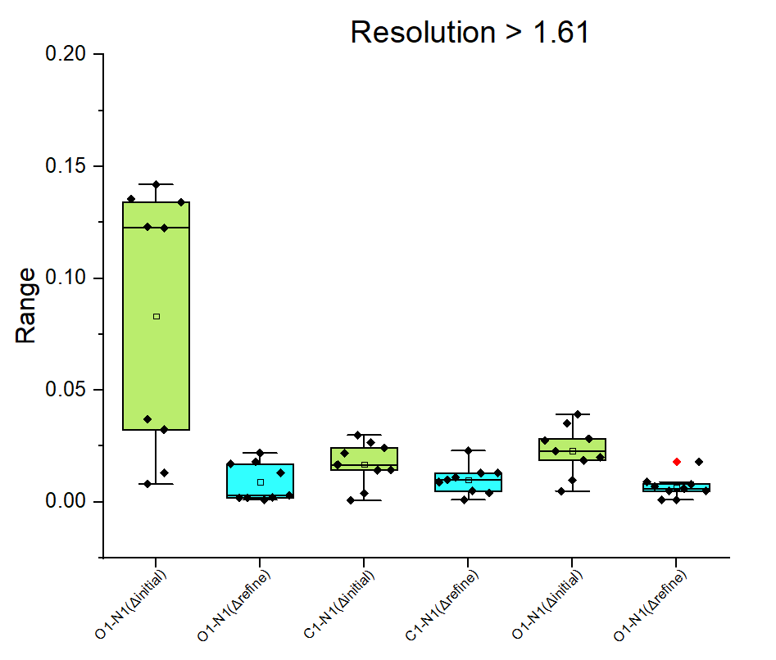
BONDS

Slide 13
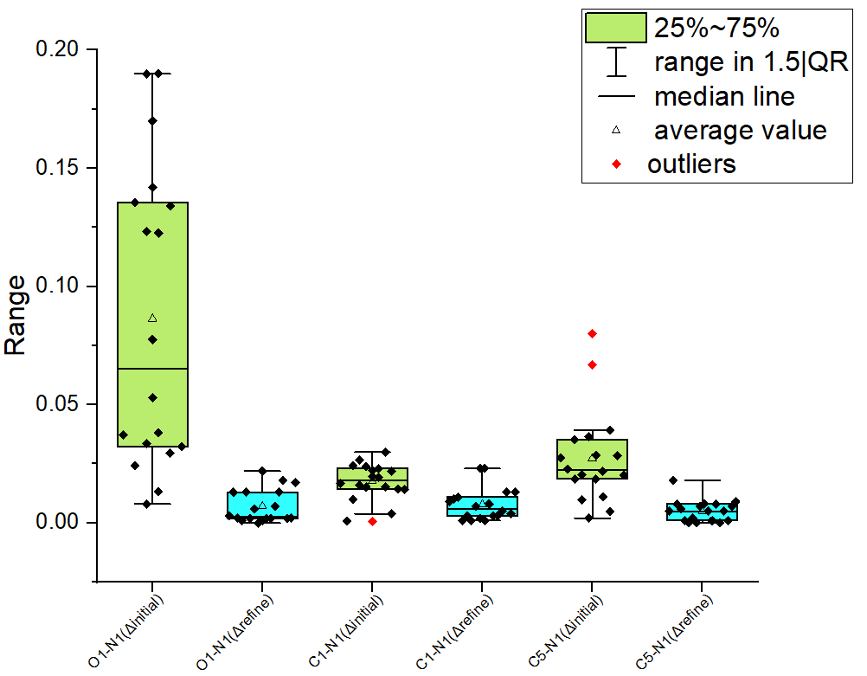
BONDS

Slide 14
pdb | resolution
2XGA | 2.3
2XIU | 1.5
3MPN | 2.25
3STZ | 2.5
4EK1 | 1.97
4WWL | 2.23
5BMH | 1.6
5BMI | 2.5
5G27 | 1.61
5JDT | 1
6N87 | 1.588

Slide 15
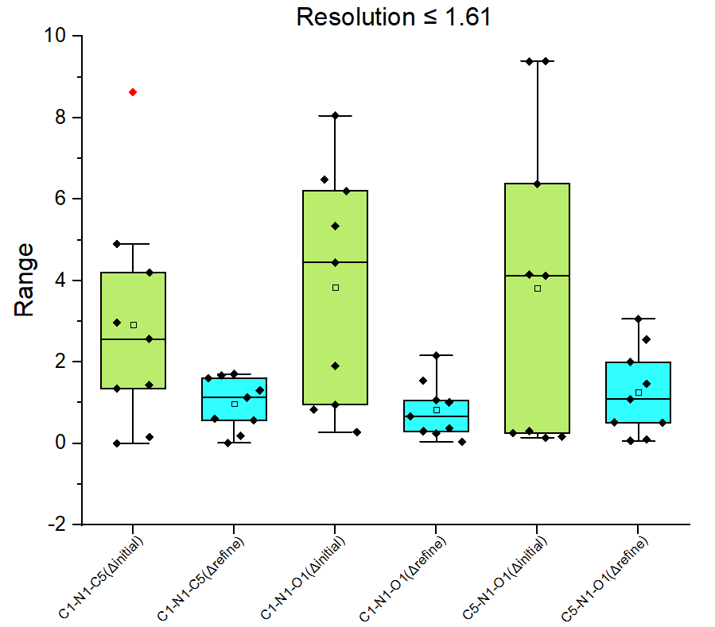
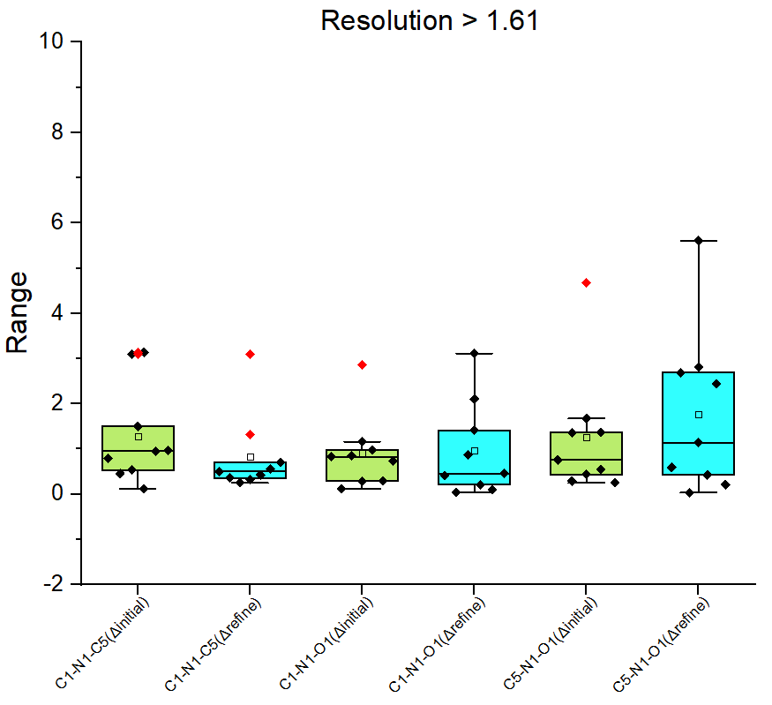
ANGLES

Slide 16
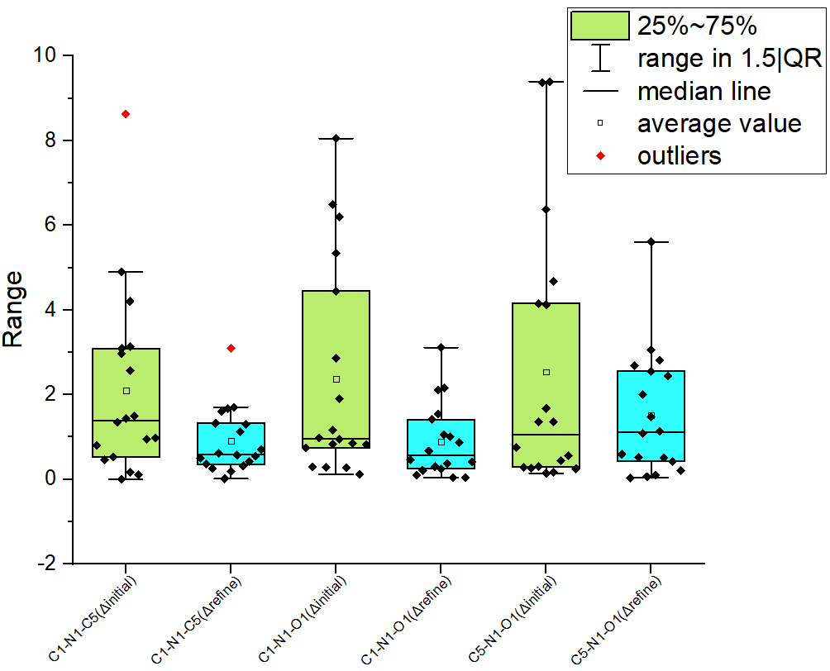
ANGLES

Slide 17
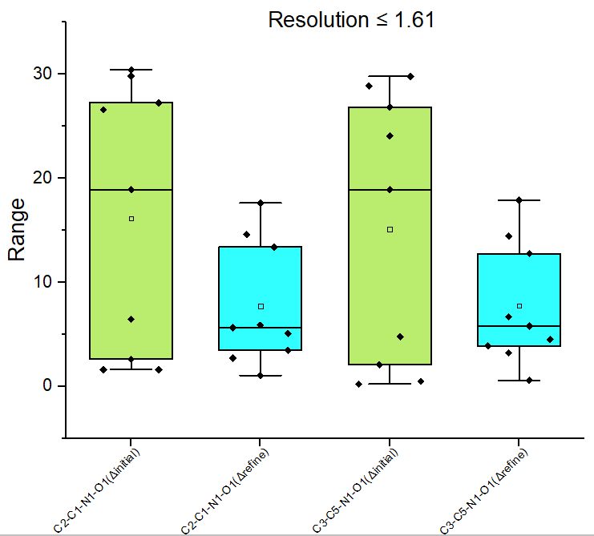
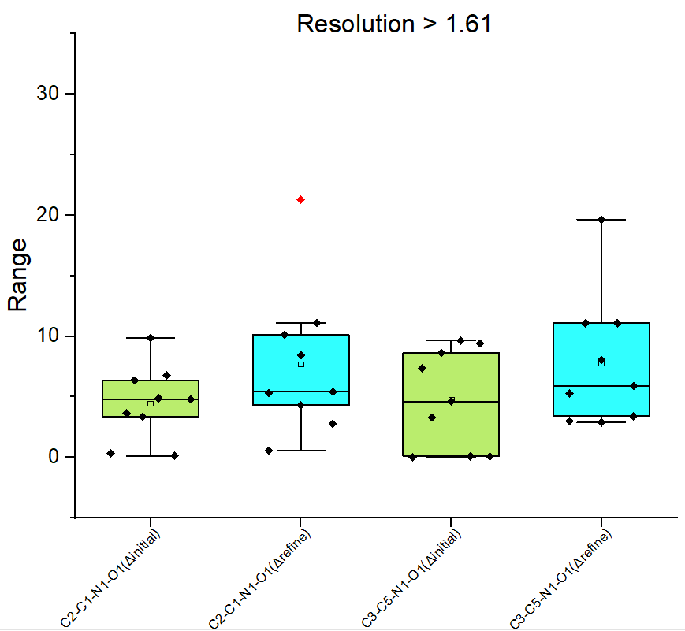
DIHEDRALS

Slide 18
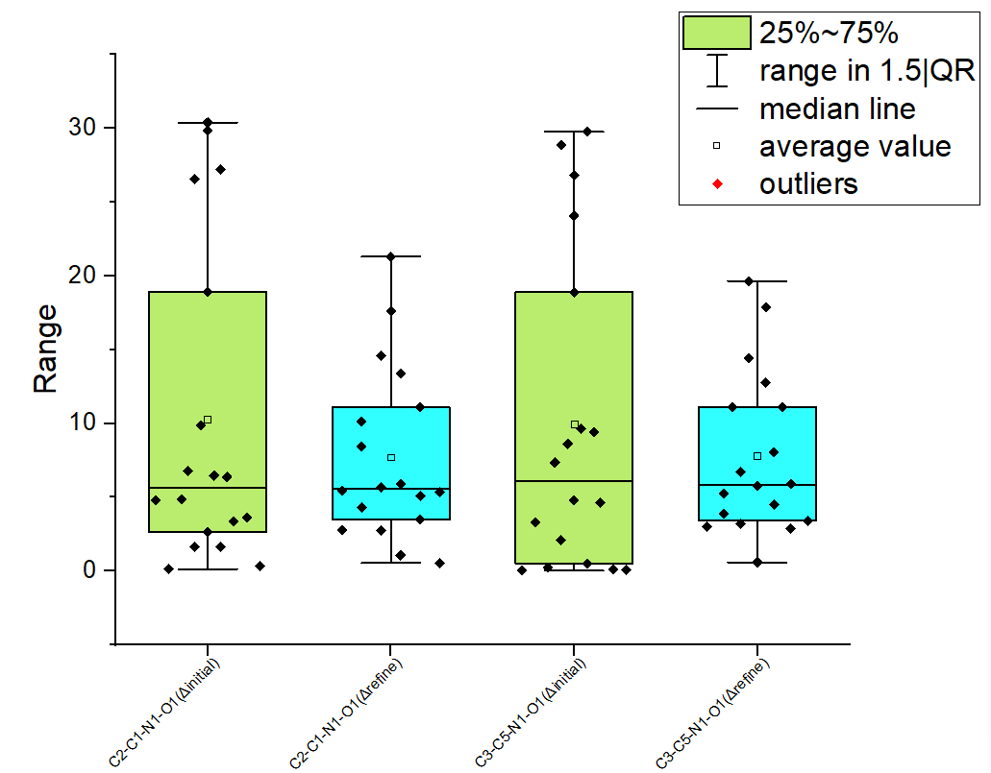
DIHEDRALS

Slide 19
THANKS FOR YOUR LISTENING!

